Slide 1



Defra / Environment Agency presentation to Transparency Board
Miles Parker, Defra: Deputy Chief Scientific Advisor,
Chair UK Location Council
Miranda Kavanagh, Environment Agency:
Director of Evidence
Transparency Board
6 September 2011

Slide 2
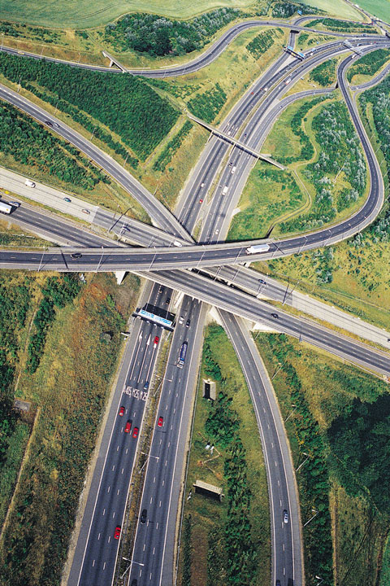
Agenda
      Introduction
      INSPIRE / UK Location Programme
      Environment Agency data and approach to open access
      Questions and discussion

Slide 3
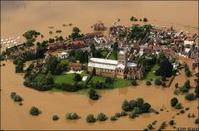
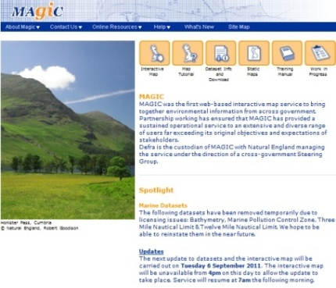
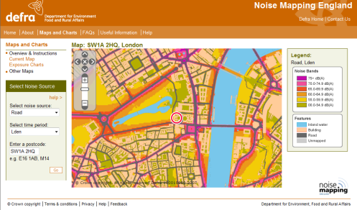
Introduction
      The Defra network is data rich, with nearly 400 datasets identified in the Government Review of Data
      Data and analysis are key to Defra’s ways of working, informing our policies and operations
      We have a strong track record in publishing accessible data (e.g. MAGIC, What’s In Your Backyard) and statistics and indicators (e.g. Biodiversity Indicators in Your Pocket, Statistical Digest of Rural England)
      Defra network has published over 400 datasets through data.gov.uk to date
      Much of Defra’s data comes from regulatory activities and has a “location” context – Defra leads UK Location Programme / INSPIRE
      Defra’s Information Strategy and response to the Government Data Review regarded as exemplars by Cabinet Office and Treasury

Slide 4



UK Location Programme
Scope
Governance
UK Location Council
UK Location Programme Board
Other groups:
User, Technical, Data

Slide 5
UKLP links with Transparency
      Promoting easier access to data: legislation, technology, guidance, connecting data providers and users - publishing large amounts of data to agreed quality standards
      Single access point with UKLP/ INSPIRE data published via data.gov.uk – spatial an non-spatial data together
      Technical standards: Open standards, re-usable formats, linked data - focus on interoperability
      Technical delivery: Defra, Cabinet Office and OS joint delivery of technical services – data publisher tools, geo-spatial enhancements to data.gov.uk
      Simplified licensing: Use of UK Government Licensing Framework, facilitating PSMA derived data exemptions
Support needed to meet INSPIRE legal requirements
Potential role for Council as crosscutting Sector Board?

Slide 6

INSPIRE data scope and deadlines
Annex I | Annex II | Annex III
Geographical names Administrative units Addresses Cadastral parcels Transport networks Hydrography Protected sites Coordinate reference systems Geographical grid systems | Elevation Land cover Ortho-imagery Geology | Statistical units Mineral resources Natural risk zones Soils Species distribution Environmental monitoring facilities Population distribution & demography Meteorological features Agriculture and aquaculture facilities Oceanographic features Area management restriction / regulation zones & reporting units | Buildings Sea regions Land use Energy resources Habitats and biotopes Human health and safety Utility and government services Atmospheric conditions Bio-geographical regions Production and industrial facilities
Deadlines Existing Data: 2011 Compliant Data: New 2012 Transformed 2017 | 2011 2015 2017 | 2013 2015 2020

Slide 7
UKLP data on data.gov.uk
 | August 2011 | 2013
INSPIRE datasets | 236 | 1000+
Total datasets | 858 | 3000+
Organisations | 35 | 100+
Data.gov.uk % | 11% | Likely to rise

Slide 8
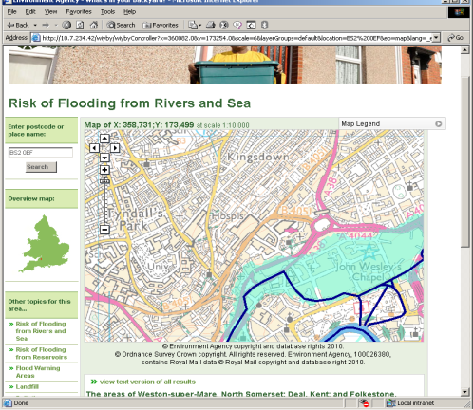
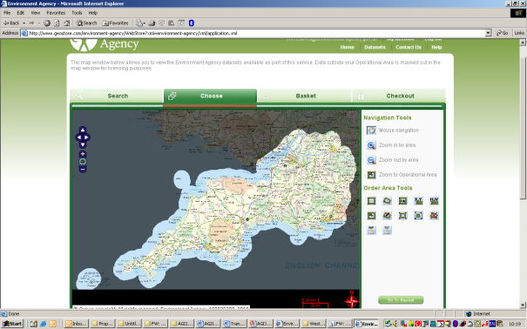
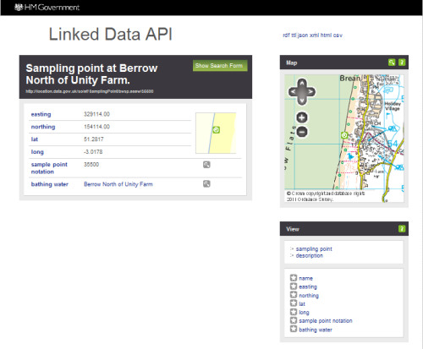
Environment Agency data and approach
      Committed to Openness and Transparency
      Significant legislative obligations (FOI / EIR / ROPSI / INSPIRE)
      40-50,000 requests for information p.a.
      Heavily used web services such as WYBY (25,000 concurrent users during floods)
      All data available free, or at marginal cost of supply, or for commercial use where charges are levied or royalties paid
      Investing more in data supply – Datashare service: 44 datasets, 2,900 users, 18,500 downloads.
      INSPIRE shared service using Datashare will be 3-star in November
      UKLP bathing water linked data pilot is 4-star moving to 5-star soon

Slide 9
Questions and discussion

